Slide 1

#FIFAWorldCup
By: Eduardo Lebron, Vivek Jadon, Kevin Fitzgerald, and Tudor Udroiu

Slide 2
What are we trying to find out?
We are looking into this social media data for the purpose of marketability.
Which players to sign for sponsorships or to be the next face of your 2019 ad campaign
In you country specific ads which player will you market in which country.
When someone looks up “BRAND Soccer” who will be pushed to the top of that Google search.
Which players have a positive image and which have a negative one.
Both in a heat of the moment scenario and in a wholistic view.
During which games will you show which ads and in what markets

Slide 3
How Did We Tackled This?
First data mine! Import tweets using FIFA World Cup Hashtags
We used our own set of words to clean based on observation.
Words relating to hyperlinks and images in twitter
Convert the file into a CSV and tokenize our tweets to allow for sentiment analysis
Using a training set created by another party we trained our classifier.
Tweets were pulled with location services so we can filter by locations sent from as well as any word search filters
Using the Naïve Bayes model we classified all our tweets as Pos or Neg
Filter by player and by location it is sent from.
We looked at 3 players Neymar, Ronaldo and, Messi.
These players play on different teams a relatively different areas geographically
From here we compared both their global positivity and also location specific positivity.

Slide 4
Assumptions/Limitations
Our model only trained for Pos & Neg but we did not take neutrality into account which can be a large swing factor in some results
Voting tweets were not filtered out
“like for Neymar and retweet for Messi” could be considered positive but is it really?
Was our train set large enough, is the model the most accurate for this syntax? Are there more social media specific models that could be more accurate?
Atypical syntax (sarcasm, short hand, emojis)
Due to time we only looked at these players within this tournament but in reality your list would encompass all players of certain caliber and on any team in professional football.
Our data is a snapshot in time

Slide 5
Accuracy?
Neutrality will affect our accuracy negatively
Small data set, with more time we could increase data set and test our theories about players and location more thoroughly

Slide 6
Improvements
When reviewing and rerunning the data we tried to improve the efficiency of our code.
We made a few adjustments and could be cleaned up more for inefficient functions or loops.
Our initial loop to convert from JSON to CSV was an IF look which is very inefficient and was replaced by a while loop which cut our operation time in half
Along with removal of only a few redundancies we were able to cut down the operation from 15minutes to 3.5minutes.
With more experience and time this could be further improved.
Our model could use improvement as stated earlier to include neutrality and potentially include more twitter syntax
Graphs we generated are not the most effective as we didn’t use non location tweets, there could be very different data if all tweets used.
Cleaning

Slide 7
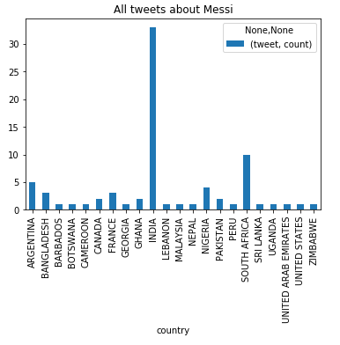
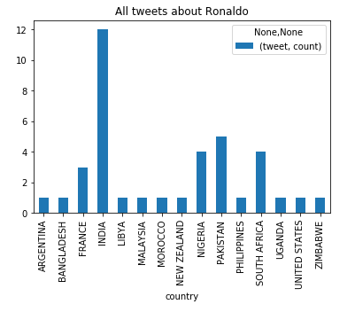
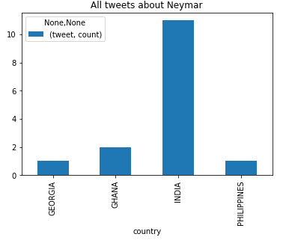
Results/Conclusions
42 Positive Tweets for Messi out of 77 for 54.545455 % of tweets where he is mentioned
26 Positive Tweets for Ronaldo out of 38 for 68.421053 % of tweets where he is mentioned
5 Positive Tweets for Neymar out of 15 for 33.333333 % of tweets where he is mentioned

Slide 8
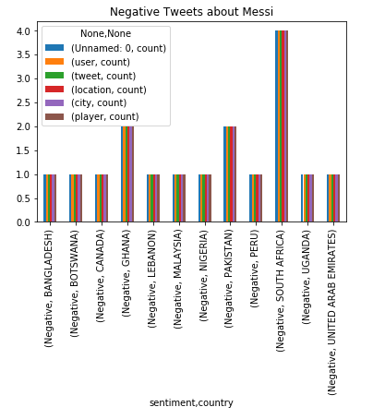
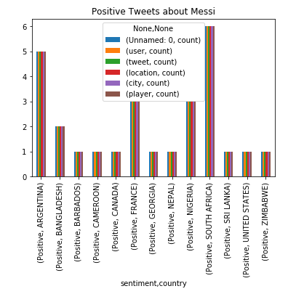
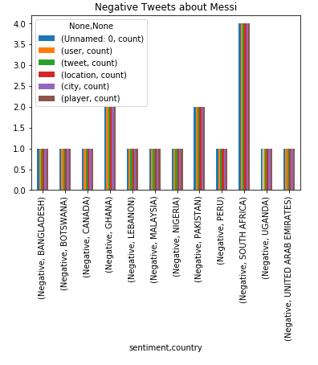

Slide 9
